Slide 1


bAvus project:
condition of road network

Slide 2
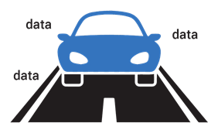


Birth of the Idea:
Utilize the abundance of data generated by trucks to analyze road quality:
Potholes, cracks, etc.
Skid resistance
Spending too much time choosing the right road to take

Slide 3
Users:
Road services
Drivers

Slide 4
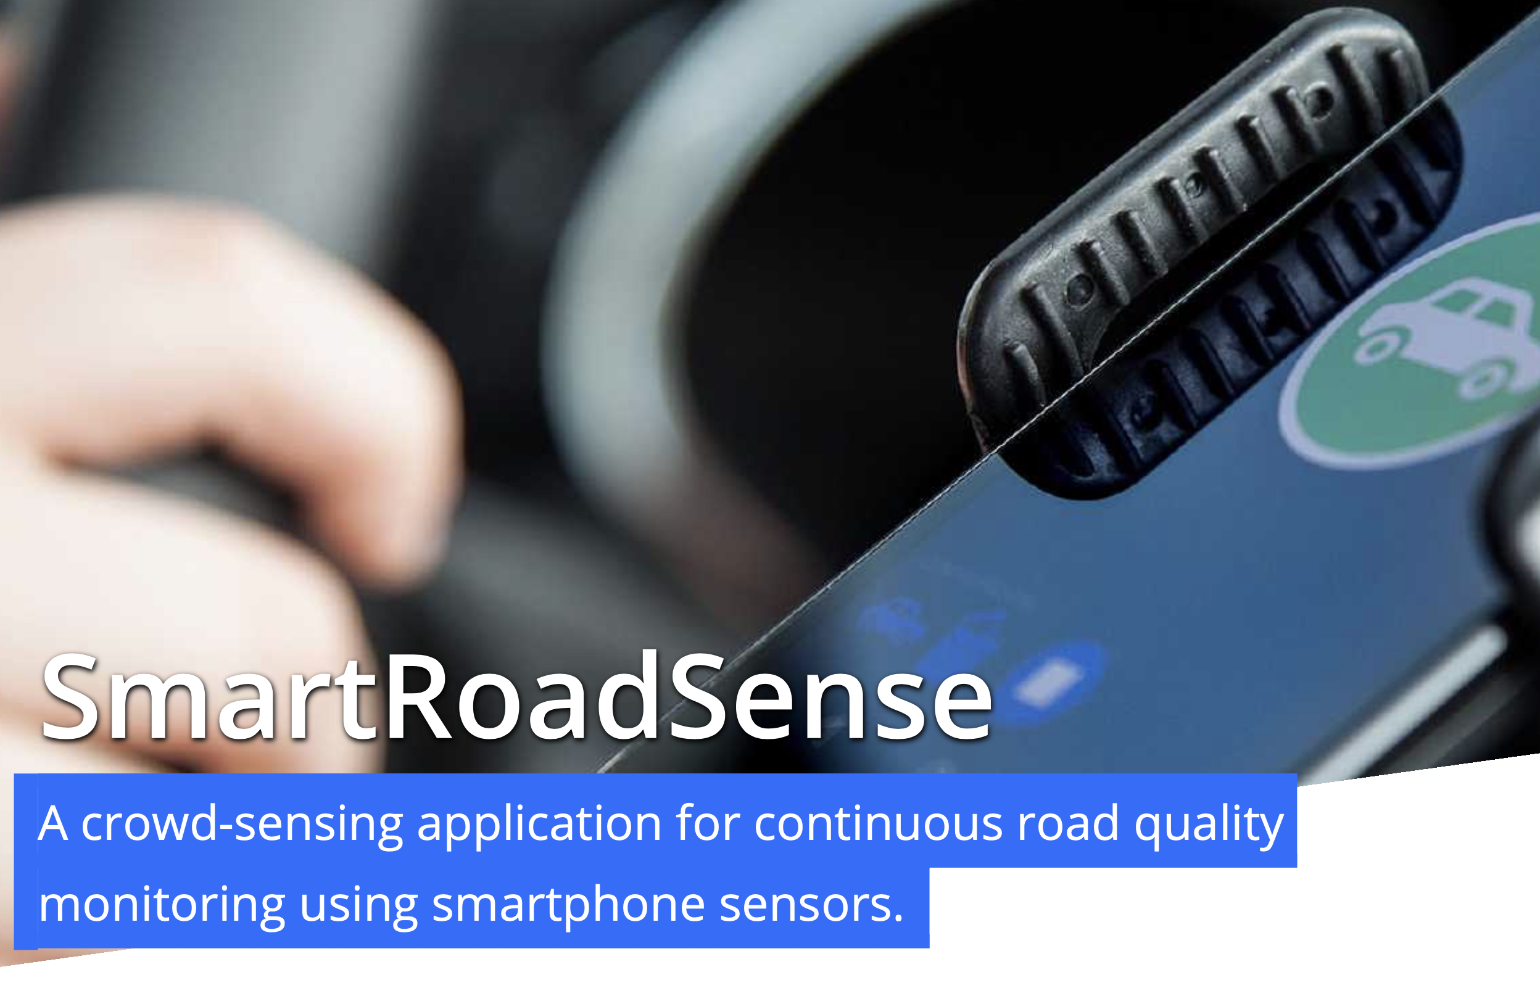


The idea to use accelerometer & GPS is not novel

Slide 5
Why would our solution work better with Fleetboard SDK
We have access to:
More accurate speed
RPM (causes noise in accelerometer data)
Suspension (more exact than accelerometer)
Weight
Gas/Brakes

Slide 6
What we did
Took a bus to gather some real-ish data
Reproduced results from research papers
Built prototype app

Slide 7
DEMO

Slide 8
Possible improvements:
Route planning for drivers using the data
Estimate skid resistance
Use more data, apply machine learning

